Slide 1
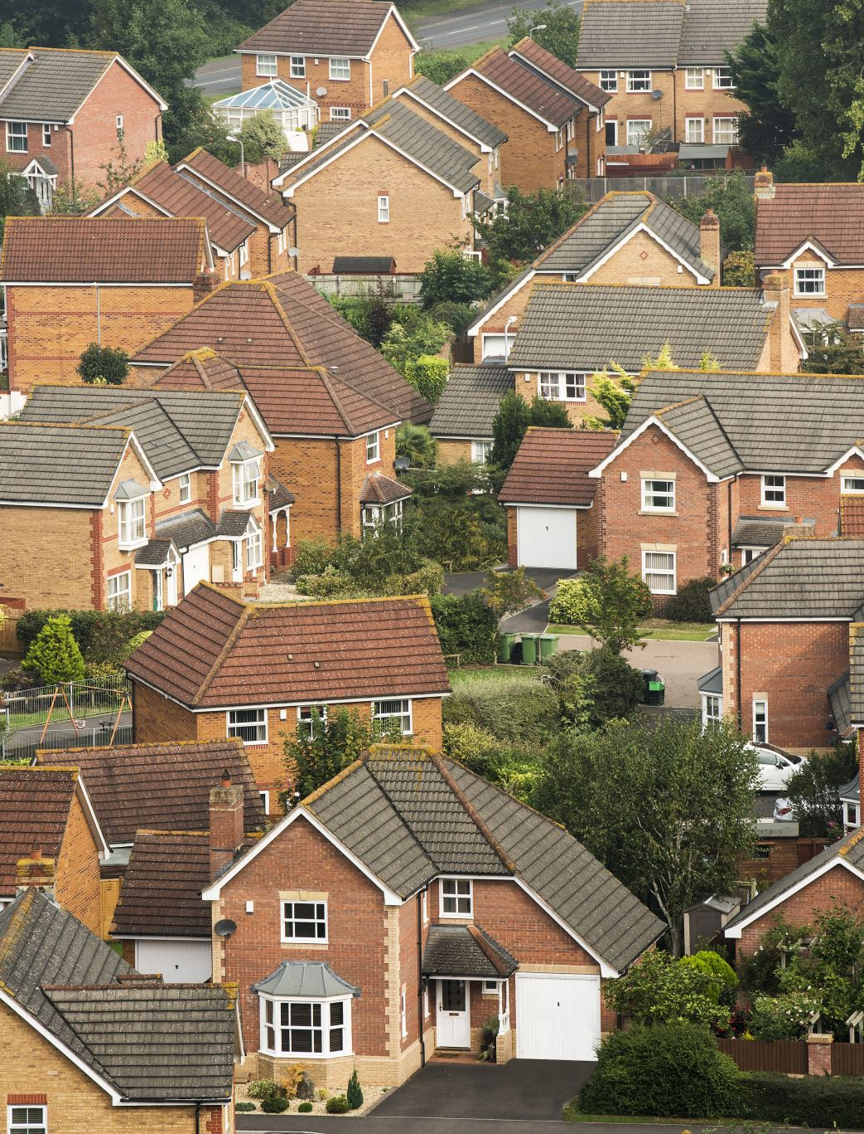
Tenant Satisfaction Analyses for Maintenance Services
15/02/2025
Prepared by Hannah Selekere

Slide 2
Introduction & Objectives
To analyse tenant satisfaction with maintenance services.
To identify areas for service improvement.
Key focus:
Most common maintenance issues.
Impact of resolution time on satisfaction.
Recommendations for service improvement

Slide 3
Overview of Data & Methodology
20XX
Sample data was gotten from Kaggle
Tools Used
Key Metrics Analysed
Tenant satisfaction scores (1-5)
Resolution time (days)
Type of maintenance issues
Rent affordability and location
Excel, Python.

Slide 4
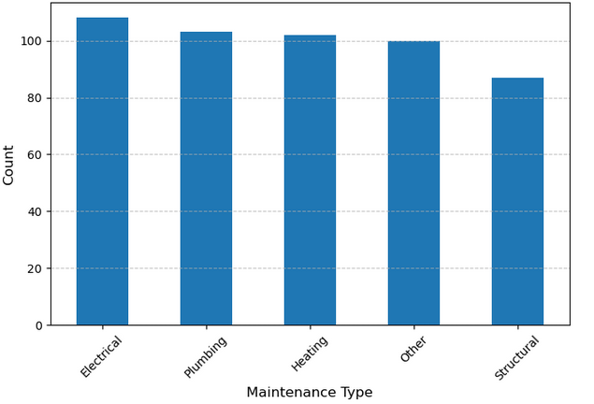
Most Common Maintenance Issues
2025

Slide 5
Tenant Satisfaction Score Distribution
2025
Key Findings
Few tenants gave a 5-star rating → Suggests service improvements are needed.
Most tenants rated their experience between 3 and 4
Implication:
There is a need to understand why high satisfaction is rare and how we can improve it

Slide 6
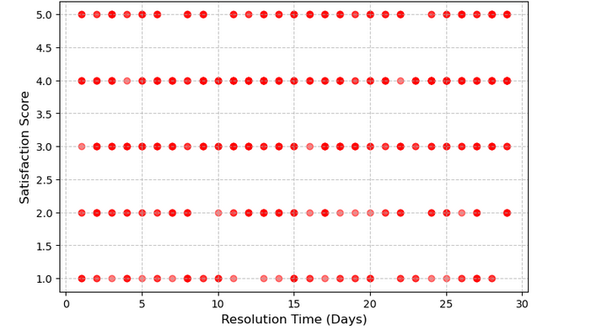
2025
Impact of Resolution Time on Satisfaction
Longer response times (20+ days) lead to lower satisfaction (1-3 ratings)
Faster responses (under 10 days) tend to have higher satisfaction (4-5 ratings).

Slide 7
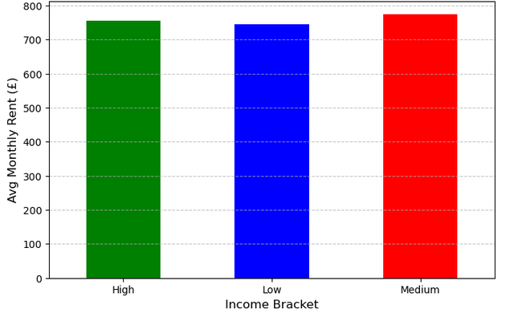
Average Monthly Rent by Income Bracket
Findings
Result
High-income tenants are paying more for housing.
Low-income tenants may struggle with maintenance affordability.

Slide 8
Recommendations
2025
Automate Ticketing System
Enhance Communication with Tenants

Slide 9
THANK YOU!
20XX
Hannah

